Slide 1
بِسْمِ اللهِ الرَّحْمٰنِ الرَّحِيْمِ

Slide 2
An Introduction to Natural Language Processing (NLP)
TOPIC NAME:
Presenter's Name:
ROHAAN NADEEM ( 03-134202-102 )
MASHOOD UR REHMAN ( 03-134202-030 )

Slide 3


What is Natural Language Processing?
  Natural language processing (NLP) studies interactions between humans and computers to find ways for computers to process written and spoken words similar to how humans do. The field blends computer science, linguistics and machine learning.

Slide 4
NLP benefits and its parts
Natural language processing has heavily benefited from recent advances in machine learning, especially from deep learning techniques. The field is divided into the three parts:
Speech Recognition
Natural Language Understanding (NLU)
Natural Language Generation (NLG)

Slide 5
Describing about the parts of NLP
Speech recognition :
the translation of spoken language into text.
Natural Language Understanding :
a computer’s ability to understand language.
Natural Language Generation:
the generation of natural language by a computer.

Slide 6
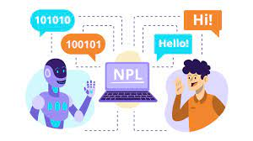
Example to differentiate parts of NLP
NLU
Structured Language:
<h1>Hello World.</h1>
<br>
<p>This is Compiler construction class.</p>
Un Structured Language:
Hello World.
This is Compiler construction class.
NLP
NLG

Slide 7
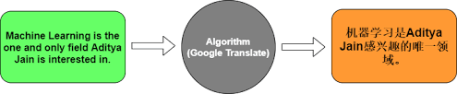
Some use case examples of NLP
Machine Translation:
give and take information commands to machine enables automatic conversion of text from one language to another, facilitating seamless communication and information access across linguistic barriers.

Slide 8


Some use case examples of NLP
Virtual assistance:
like chat bot Siri, Alexa allowing users to ask questions, control smart devices, and access information effortlessly through voice commands and text input.

Slide 9



Some use case examples of NLP
Sentiment analysis: which type of opinion, emotions or attitude. Expressions can be classified as positive, negative, or neutral.
Spam detection: Like email, message inappropriate content which make it to go to spam.

Slide 10

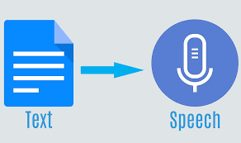
Some use case examples of NLP
Speech Recognition: Voice Recognition focuses on processing voice data to convert it into a structured form such as text.
Text To Speech: Conversion Using NLP means converting text to the voice speech using NLP. NLP is a field of artificial intelligence that gives the machines the ability to read, understand, and derive meaning from human languages.

Slide 11
How NLP works:
Tokenization
Stemming Lemmatization
Part of speech tagging
Named entity recognition (NER)

Slide 12
Tokenization
Tokenization is the start of the NLP process, converting sentences into understandable bits of data that a program can work with. Without a strong foundation built through tokenization, the NLP process can quickly devolve into a messy telephone game.
There are several different methods that are used to separate words to tokenize them. Like meaningful token or sub token.
Characters like: ‘,’ or ‘;’ or ‘“,”’
Query “What is the tallest building?” would be broken down into ‘what’ ‘is’ ‘the’ ‘tall’ ‘est’ ‘build’ ‘ing’

Slide 13
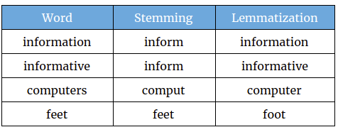
Difference between Stemming & Lemmatization
Stemming is a process that stems or removes last few characters from a word, often leading to incorrect meanings and spelling.
Lemmatization considers the context and converts the word to its meaningful base form, which is called Lemma.

Slide 14

Part of speech tagging
Part-of-speech (POS) tagging is a process in natural language processing (NLP) where each word in a text is labeled with its corresponding part of speech. This can include nouns, verbs, adjectives, and other grammatical categories.

Slide 15

Named Entity Recognition (NER)
Named entity recognition (NER) is a form of natural language processing (NLP) that involves extracting and identifying essential information from text. The information that is extracted and categorized is called entity. It can be any word or a series of words that consistently refers to the same thing.

Slide 16
Why NLP is Hard?
Ambiguity
Scale
Sparsity
Variation
Expressivity
Unmodeled Variables
Unknown representations

Slide 17
Ambiguity
Ambiguity at multiple levels
Word senses: bank (finance or river ?)
Part of speech: chair (noun or verb ?)
Segmenting text into words
Words with multiple meanings: bank, mean
Multiword expressions: make a decision, take out, make up

Slide 18

Expressivity

Slide 19
Successes
  NLP is important because it helps resolve ambiguity in language and adds useful numeric structure to the data for many downstream applications, such as speech recognition or text analytics.
  Product knowledge bases need to be translated into multiple languages
  Hiring a large multilingual support staff is expensive
  Machine translation is cheaper and accurate with predictable texts.
  Microsoft, Autodesk, Symantec, and Intel use it.
    Makes customers happy
    Still readable though slightly chunkier than human translations

Slide 20


